Slide 1
Tuberculosis Detection using Deep Learning
CREATED BY : Simran Paul

Slide 2
Problem Statement
The system will preprocess and augment image data, train multiple deep learning models, and evaluate their performance. The final application will provide an interface for uploading X-ray images and receiving predictions

Slide 3
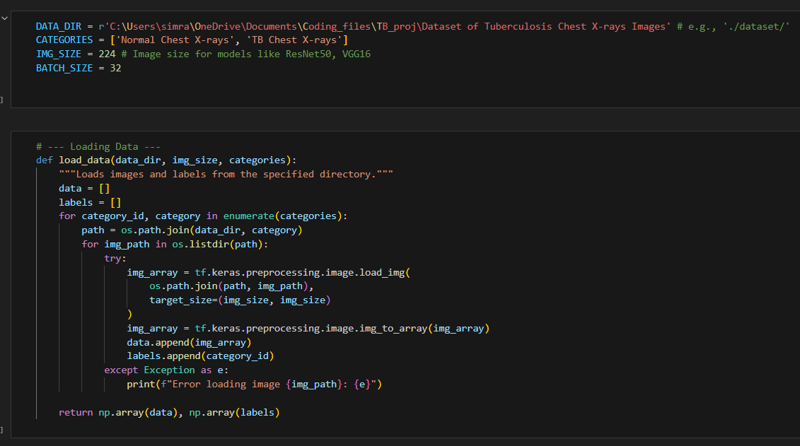
Data Loading

Slide 4
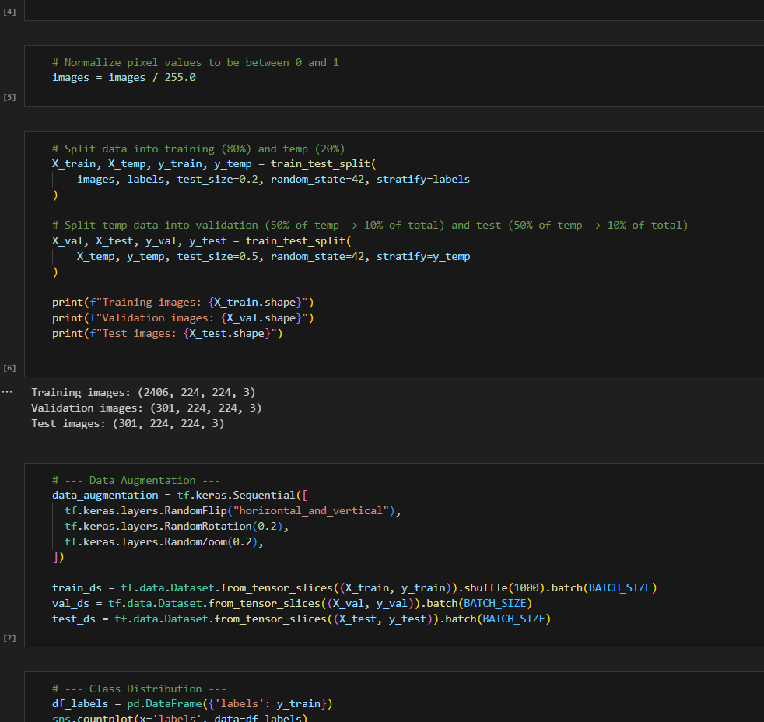
Normalizing and Splitting the data

Slide 5
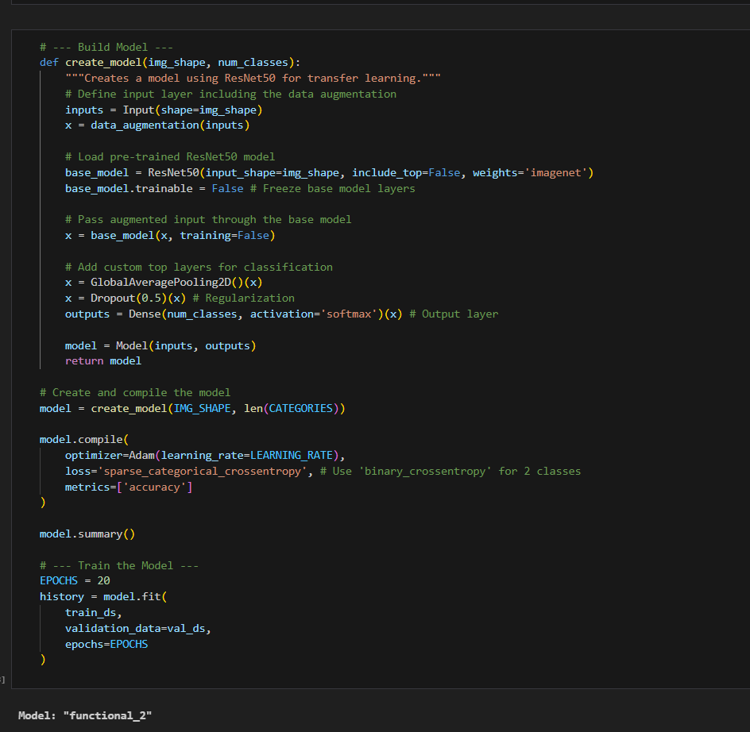
Model Training

Slide 6
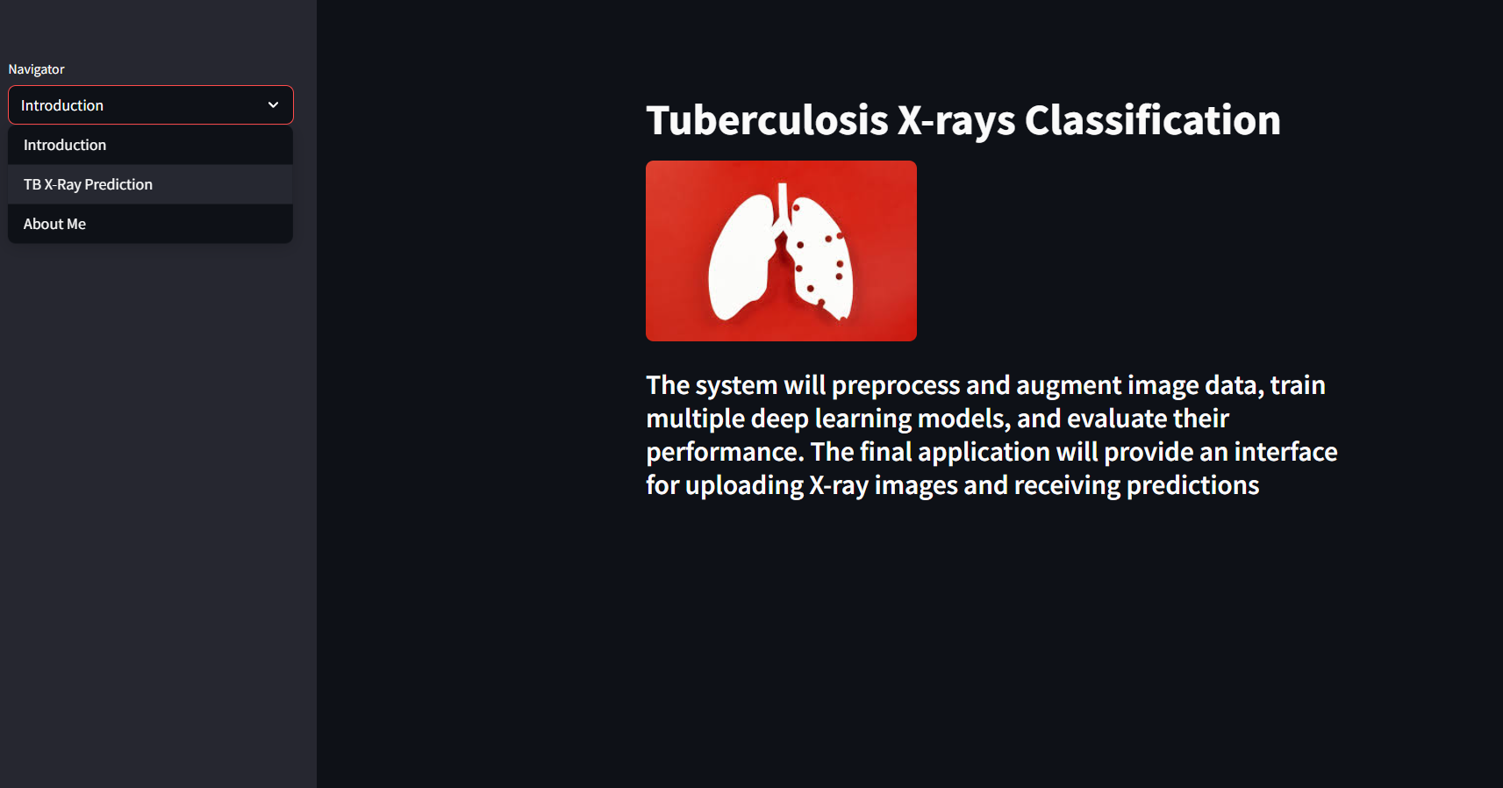
Streamlit (intro)

Slide 7
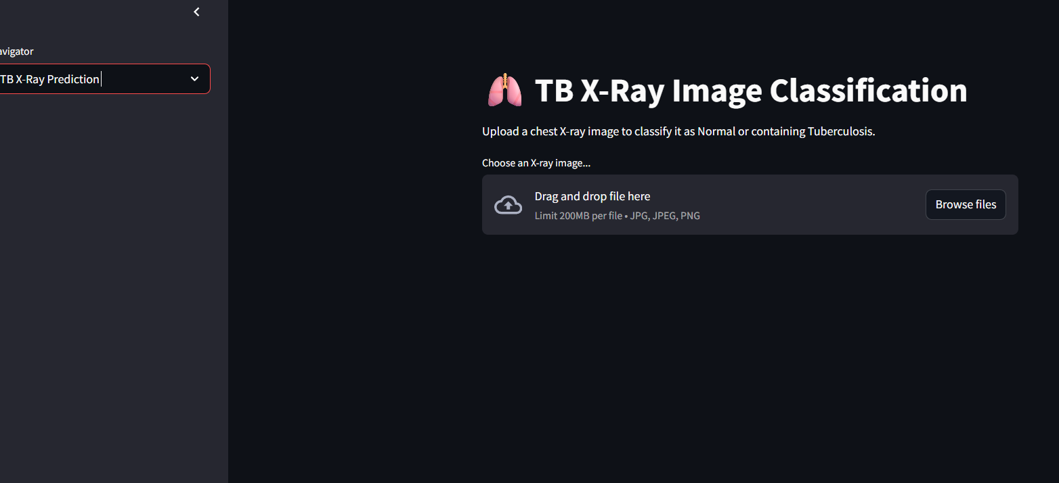
Streamlit (TB X-rays classifcation)

Slide 8


